Slide 1
Welcome to my project presentation

Slide 2
Presentation by: Neha Kumari

Slide 3
Name of the project
Fake news Project

Slide 4
Problem Statement
-Context
Fake news has become one of the biggest problems of our age. It has serious impact on our online as well as offline discourse. One can even go as far as saying that, to date, fake news poses a clear and present danger to western democracy and stability of the society.
-Content
What's inside is more than just rows and columns. Make it easy for others to get started by describing how you acquired the data and what time period it represents, too.
What is a Fake News?
Fake news's simple meaning is to incorporate information that leads people to the wrong path. Nowadays fake news spreading like water and people share this information without verifying it. This is often done to further or impose certain ideas and is often achieved with political agendas.
For media outlets, the ability to attract viewers to their websites is necessary to generate online advertising revenue. So it is necessary to detect fake news.

Slide 5
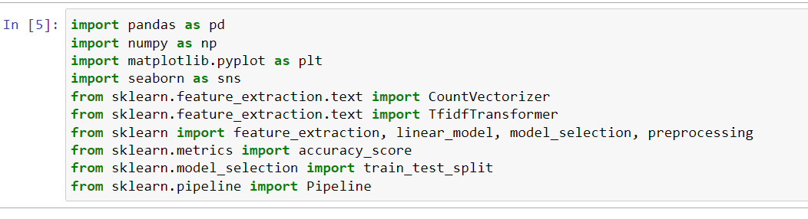
Using library for detection

Slide 6
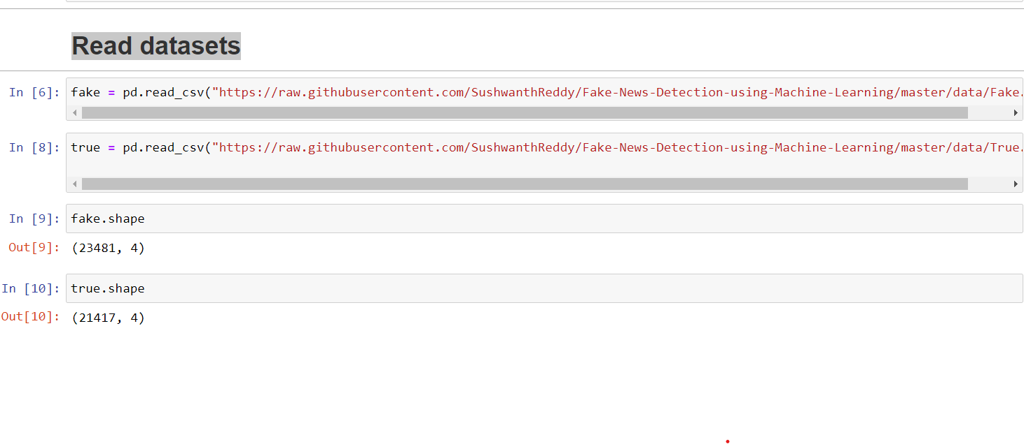
Read datasets & Analysis

Slide 7
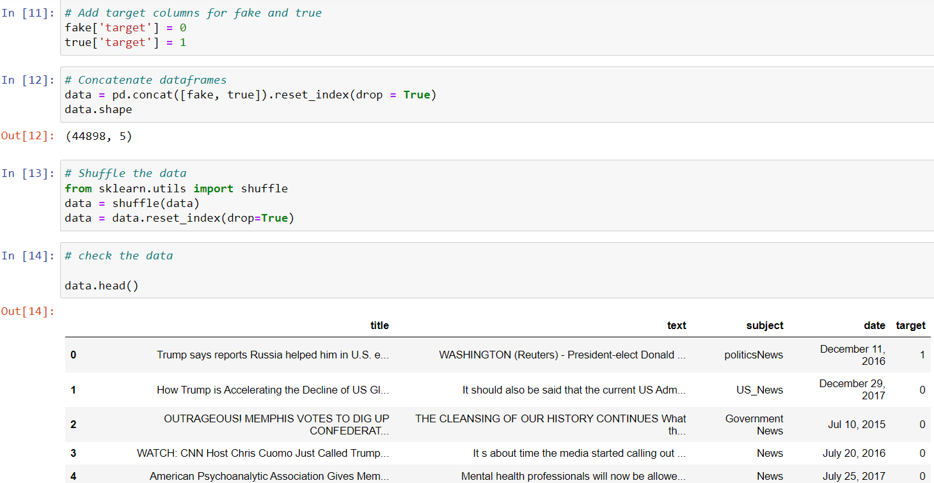
Data cleaning and preparation¶

Slide 8
Removing the date (we are not using it for the analysis)
Checking Null values
Removing the title (we will only use the text)
Remove punctuation
Removing stopwords

Slide 9
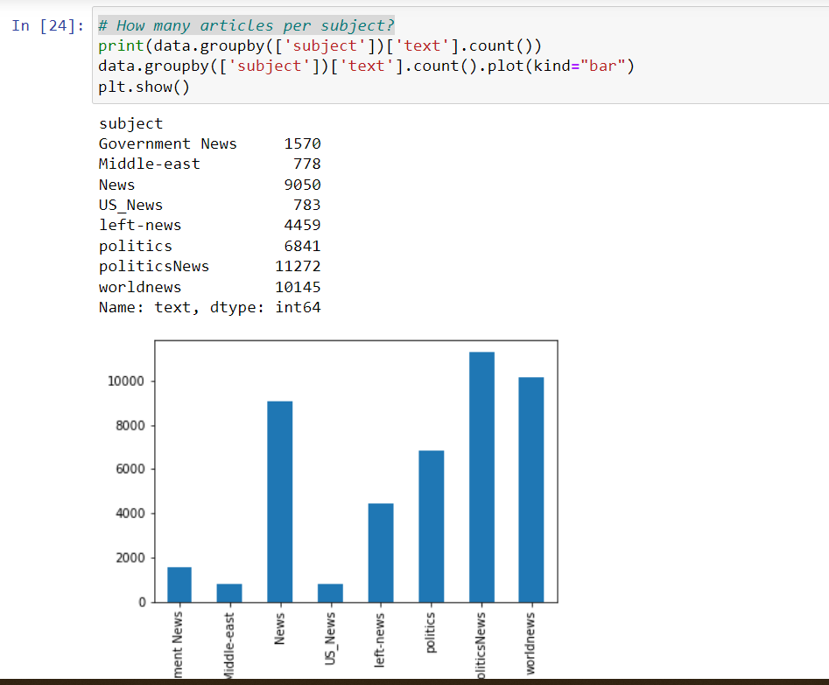
EDA Process
We are using count plot for # How many articles per subject?

Slide 10
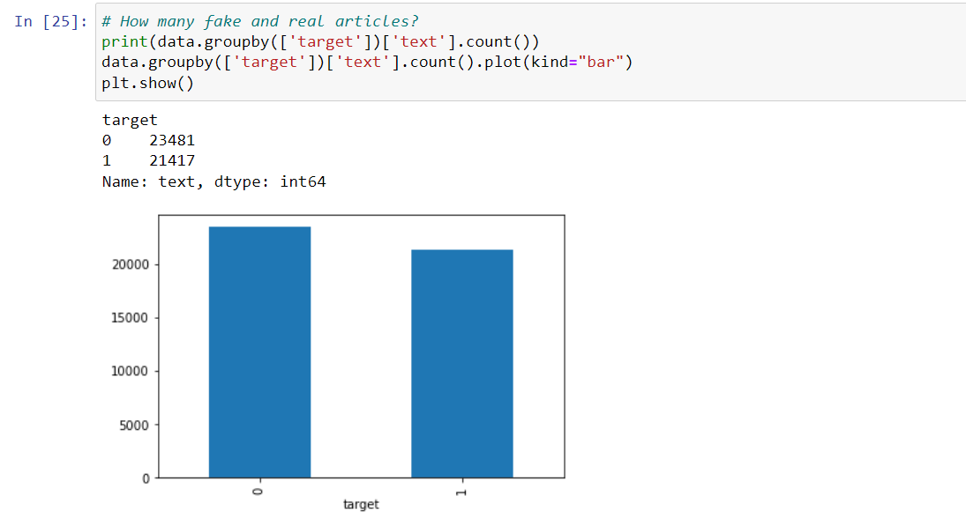

Slide 11
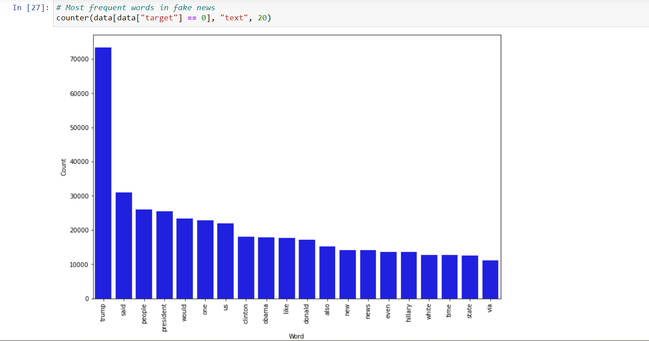

Slide 12
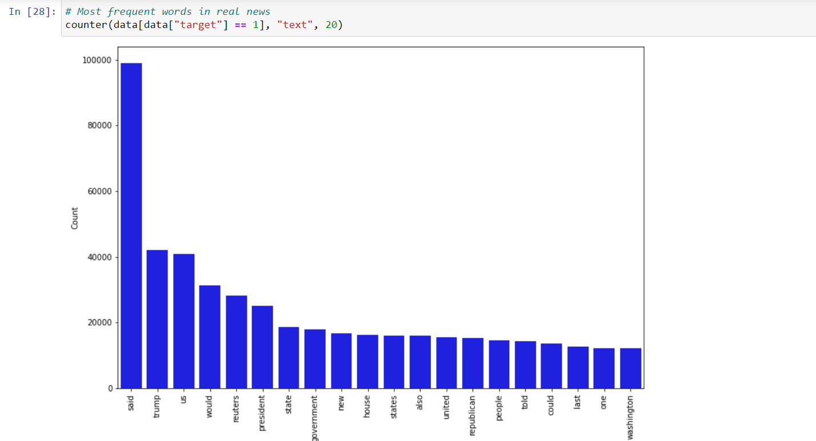

Slide 13
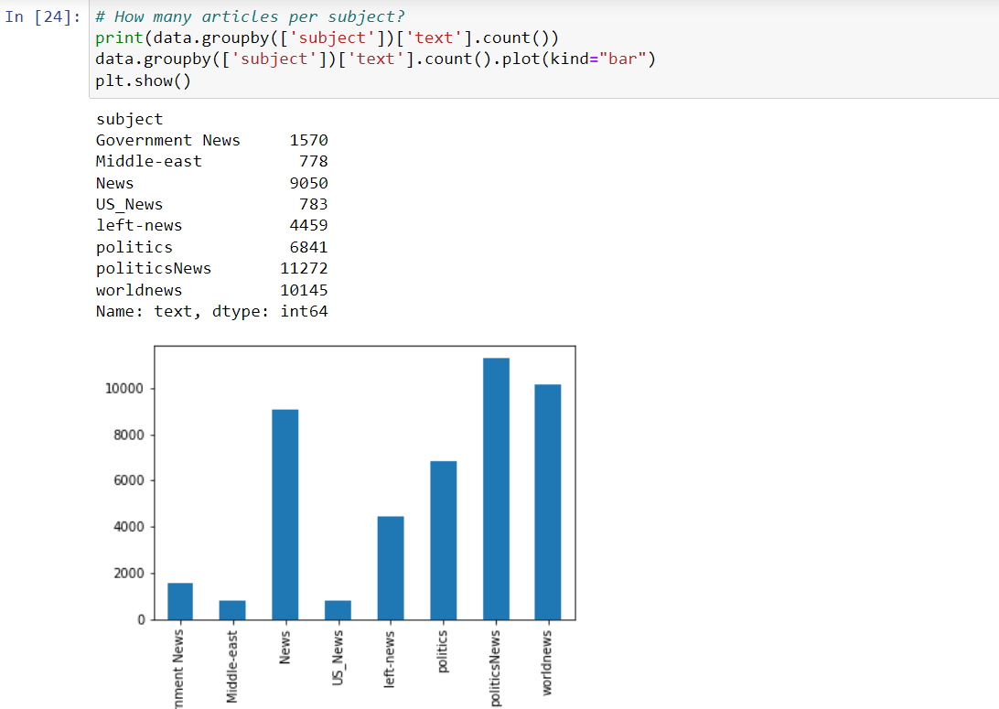

Slide 14
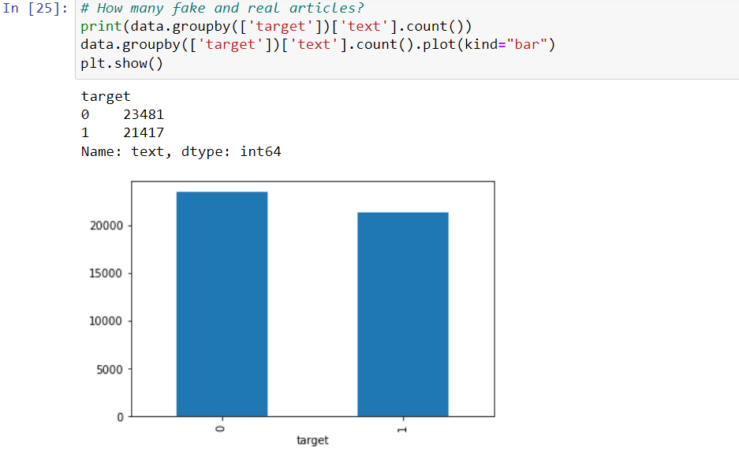

Slide 15
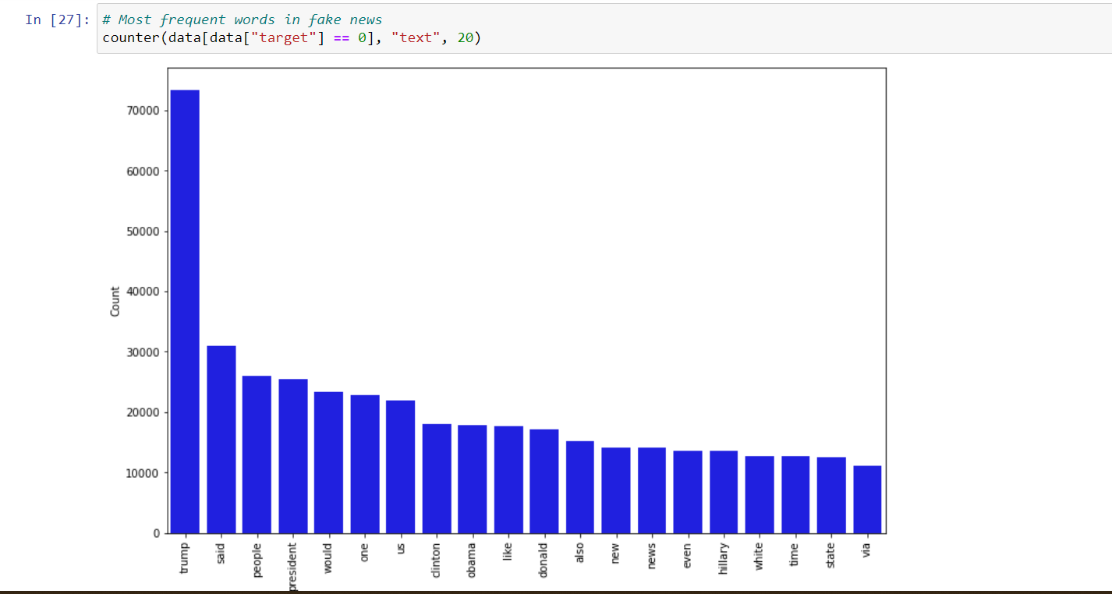

Slide 16
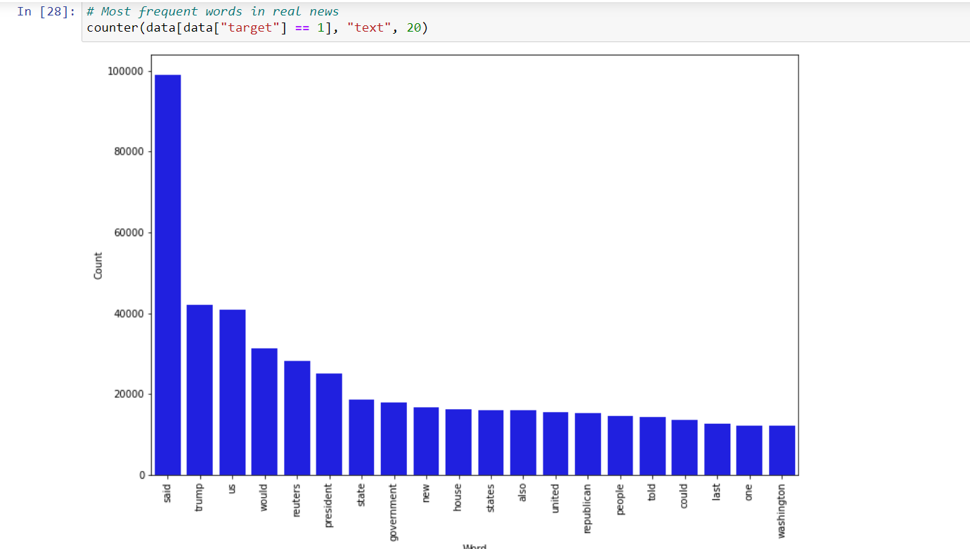

Slide 17
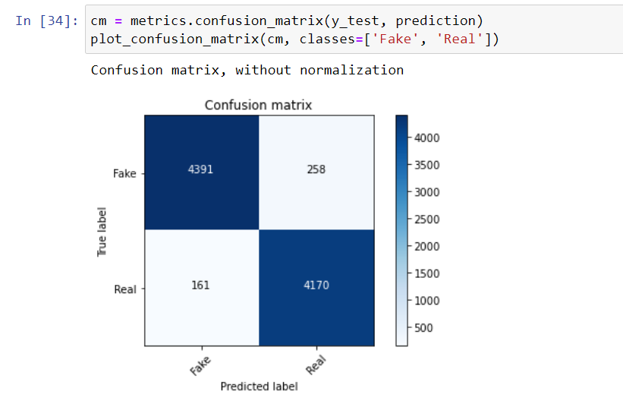
Model building
accuracy: 95.33%
# Split the data
X_train,X_test,y_train,y_test = train_test_split(data['text'], data.target, test_size=0.2, random_state=42)
Using model
Naïve bayes – accuracy :95.33%

Slide 18
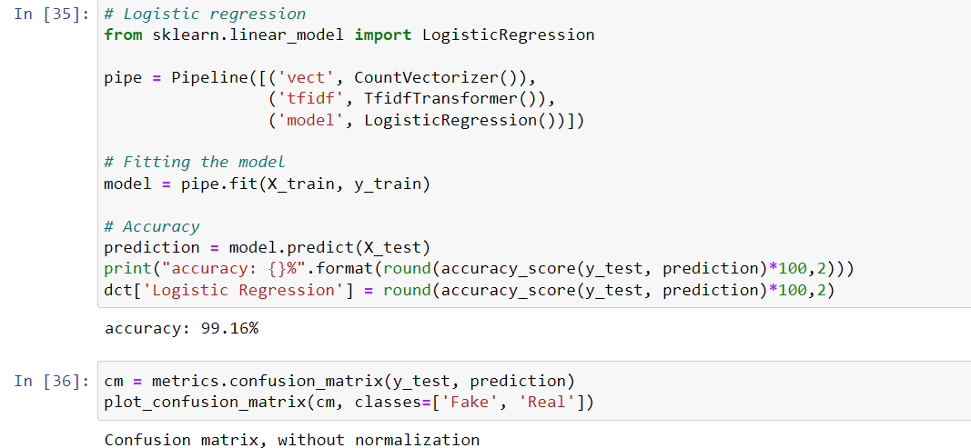
Logistic regression

Slide 19
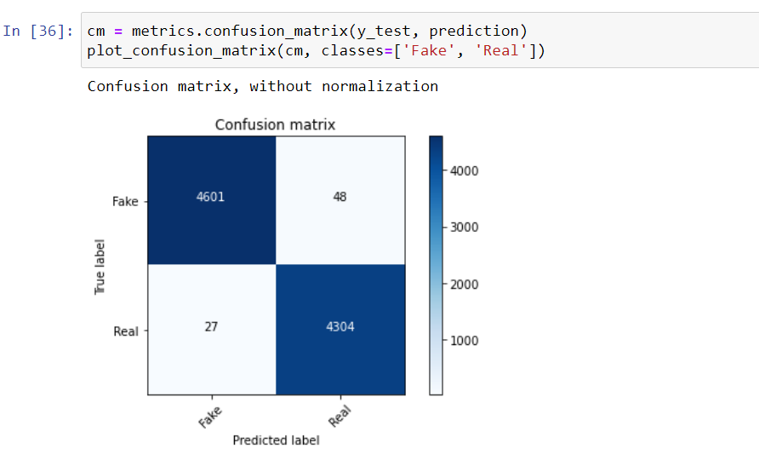

Slide 20
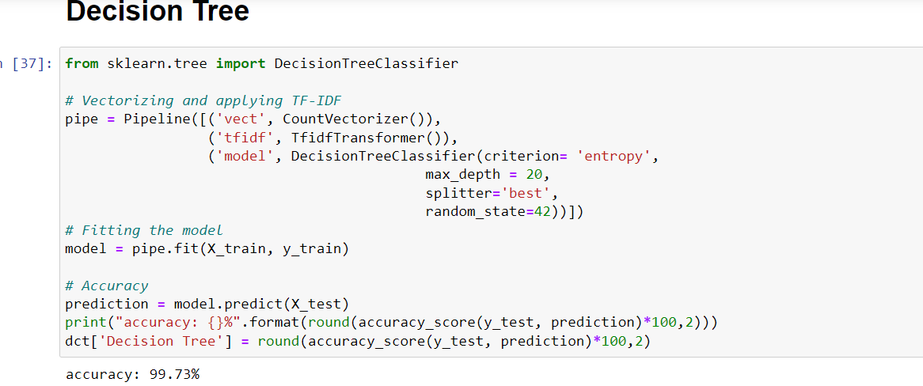
Decision Tree

Slide 21
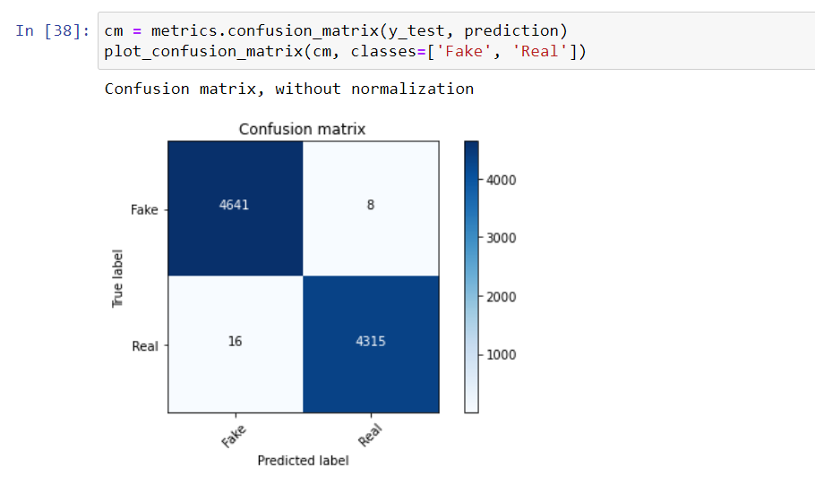
Confusion Matrix

Slide 22
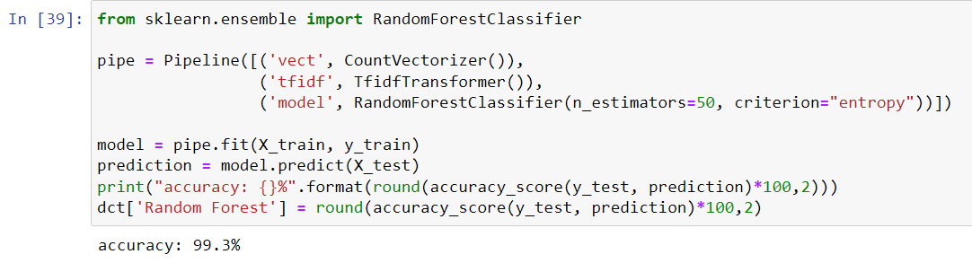
Random Forest Classification

Slide 23
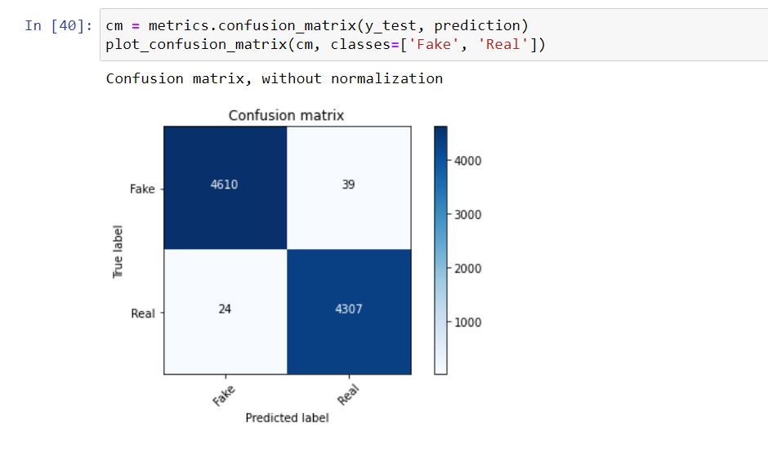
Confusion Matrix

Slide 24
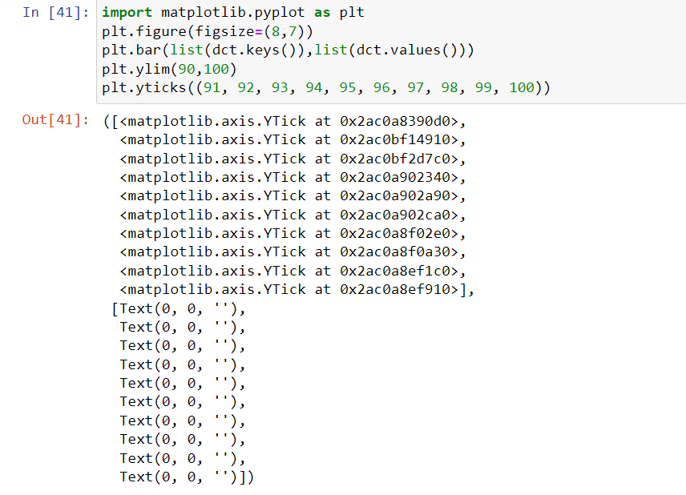
Comparing Different Models

Slide 25
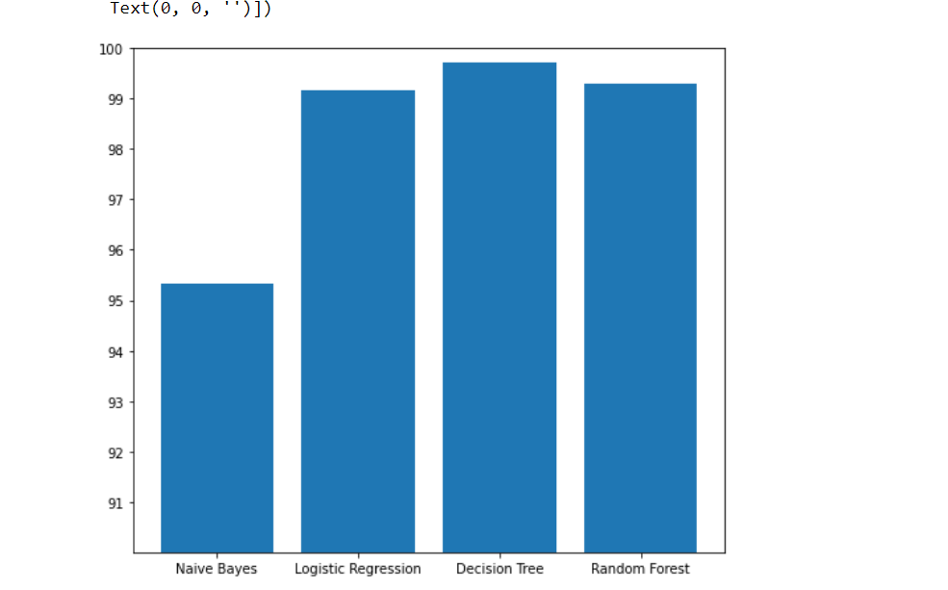
Plot

Slide 26
Conclusion :¶
we have applied many algorithm like (Naive Bayes , Logistic Regression,Decision Tree ,Random Forest ). but as we can see that Decision Tree has given the best accuracy score

